Slide 1

Realism: (nearly real)

Slide 2
Content Note
This lecture discusses multiple texts and ideas. These include texts concerning
enslavement and torture
Horror
Voyeurism and stalking
facial difference

Slide 3
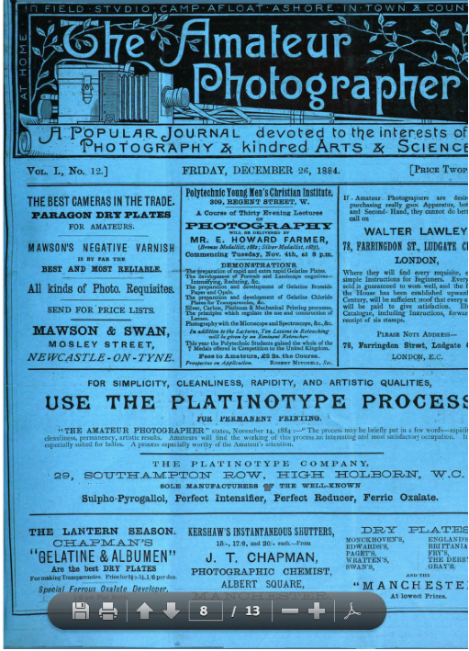

Slide 6
4.‘She had never been satisfied with the portraits which professional photographers made for her. She felt sure that her sweetest expression had not been caught by the camera, as she often saw it in her mirror. Having a camera with the usual attachment for taking instantaneous views, she has spent her leisure hours for a week or two in making negatives of her own visage. A string hitched to the trigger of the instrument enables her to be both operator and subject; and thus, in the privacy of her chamber . . . she transfers her smiles or frowns to the plates to be subsequently developed into photographs, in case she deems them worth it. She has thus far made one hundred and sixty-seven different pictures of herself.’ The Amateur Photographer, July 24 1885, 242.

Slide 7
4.‘She had never been satisfied with the portraits which professional photographers made for her. She felt sure that her sweetest expression had not been caught by the camera, as she often saw it in her mirror. Having a camera with the usual attachment for taking instantaneous views, she has spent her leisure hours for a week or two in making negatives of her own visage. A string hitched to the trigger of the instrument enables her to be both operator and subject; and thus, in the privacy of her chamber . . . she transfers her smiles or frowns to the plates to be subsequently developed into photographs, in case she deems them worth it. She has thus far made one hundred and sixty-seven different pictures of herself.’ The Amateur Photographer, July 24 1885, 242. 4b [The Editor will be glad to receive communications for these columns which must be authenticated by the name and address of the sender.] ibid.

Slide 8
‘Realism is a notoriously difficult aesthetic to pin down, in part because the concept of reality itself is constantly changing and being recontested’ Matthew Beaumont and Anna Despotopoulou, ‘Realism’, Oxford Bibliographies Online. 5b. ‘Realism is nothing more and nothing less than the truthful treatment of material’ William D. Howells, Criticism and Fiction [first pub.1891] (New York: New York University Press, 1959), p.38.

Slide 9
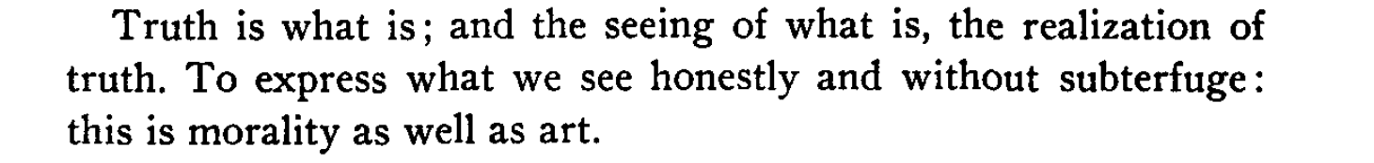
Theodore Dreiser, ‘True Art Speaks Plainly’ (1903) Booklovers Magazine 1: p. 129, February 1903.

Slide 10
6. ‘In so far as realism pretends to offer an unproblematic representation, it is in fact the most deceptive form of representation, reproducing its assumptions through the audience’s unexamined response to an apparently natural image or text.’ Nigel Wheale, The Postmodern Arts: An Introductory Reader (London: Routledge, 1995), p.51.

Slide 11
6b. ‘Both Levine and Bersani viewed the realist novel … as struggling at an imaginative level to repair fractures’
Frances O’ Gorman, The Victorian Novel: A Guide to Criticism (Oxford: Blackwell, 2002), p.120.

Slide 12
7. ‘Realism was in the spirit of the democratizing movements of the nineteenth-century, bringing into literary or painterly view common worlds of experience that had previously been aesthetically unseen or out of bounds. The extension of the constituencies of political representation went along with an extension of the field of artistic representation’
Rachel Bowlby, ‘Foreword’ to Adventures in Realism, ed. Matthew Beaumont (Oxford: Blackwell, 2007), p.xiii.

Slide 13
Living in the nineteenth century, in a time of… democracy, and liberalism, we asked ourselves whether what are called “the lower classes” did not have a right to the Novel, whether this world beneath a world, the people, must remain under …the distain of authors, who up to now have kept silence about whatever heart and soul the people might have. We asked ourselves whether in this era of equality in which we live there could still be, for writer or for reader, any classes too unworthy …
‘On True Novels’ on Edmund and Jules de Goncourt, ‘Preface’ to Germinie Lacerteux (1865)

Slide 14
7b. ‘The truth of infinite value that [Ruskin] teaches is realism – the doctrine that all truth and beauty are attained by a humble and faithful study of nature, and not by substituting vague forms, bred by the imagination on the mists of feeling, in place of definite, substantial reality’
George Eliot, review of Ruskin’s Modern Painters III, ‘Art and Belles Lettres’, The Westminster Review 65 (April, 1856). Quoted in Luc Herman, Concepts of Realism (Columbia: Camden House, 1996), p.20.

Slide 15
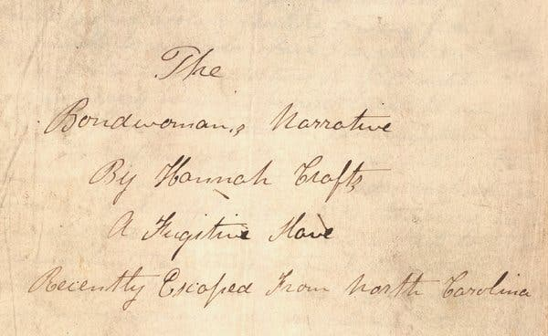

Slide 16
George Eliot, Elizabeth Gaskell, Henry James, George Gissing, George Moore, Gaskell, Brontës, Dickens, W. D. Howalls,

Slide 17
Sarah E Farro second known African-American woman novelist published in the 19th century True Love: A Story of English Domestic Life.
William Wells Brown, author of Clotel, or the President’s Daughter (1853)
Harriet E. Wilson, Our Nig, or Sketches from the Life of a Free Black was published anonymously in 1859
Frank J. Webb., The Garies and Their Friends

Slide 19
My mistress was very kind, and unknown to Master she indulged me in reading whenever I desired. The next morning I descended to the parlor, and seated myself with a book behind the heavy damask curtains that shaded the window
from Hannah Crafts [?], The Bondswoman’s Narrative (? 1860)

Slide 20
Hannah Crafts [?], The Bondswoman’s Narrative (? 1860)

Slide 21
My heart beat audibly….There might be a robber in the house…before I had time to decide old Jo, a negro, who loved above all things to indulge in strong potations of brandy, bust into my apartment in the most ludicrous state of terror conceivable. His eyes, large and glaring, seemed actually starting from their sockets…..he cried out ‘ …. ‘I can’t ‘scribe it, but orful, so orful, that I jumped up quicker dan dese old bones hab moved…’ Oh: Missus, de ghost, de ghost, sabe me from de ghost’ Hannah Crafts [?], The Bondswoman’s Narrative (? 1860)

Slide 22
‘In so far as realism pretends to offer an unproblematic representation, it is in fact the most deceptive form of representation, reproducing its assumptions through the audience’s unexamined response to an apparently natural image or text.’
Nigel Wheale, The Postmodern Arts: An Introductory Reader (London: Routledge, 1995), p.51.

Slide 23
11. ‘With a single drop of ink for a mirror, the Egyptian sorcerer undertakes to reveal to any chance comer far-reaching visions of the past. This is what I undertake to do for you, reader. With this drop of ink at the end of my pen, I will show you the roomy workshop of Mr. Jonathan Burge, carpenter and builder, in the village of Hayslope, as it appeared on the eighteenth of June, in the year of our Lord 1799.
The afternoon sun was warm on the five workmen there, busy upon doors and window-frames and wainscoting. A scent of pine-wood from a tentlike pile of planks outside the open door mingled itself with the scent of the elder-bushes which were spreading their summer snow close to the open window opposite
George Eliot, Adam Bede (1859), Chapter 1.

Slide 24
Victorian novelists understood realistic representation to be, like virtuality, an effort at similitude that is ultimately unrealizable…an imaginative experience that is not fully realized, but aspirational’
Alison Byerly, Are We Nearly There Yet? p. 7

Slide 25
It would have demanded the poetic passion of some joyous Elizabethan lyrist like Lodge, Nash, or Constable, to fitly phrase Paula's presentation of herself at this moment of absolute abandonment to every muscular whim that could take possession of such a supple form. The white manilla ropes clung about the performer like snakes as she took her exercise, and the colour in her face deepened as she went on. Captain De Stancy felt that, much as he had seen in early life of beauty in woman, he had never seen beauty of such a real and living sort as this.’
Thomas Hardy, A Laodicean (1881), Book 2: Dare and Havill, Chapter 7.

Slide 26
‘[P]hotography dealt a mortal blow’ to old modes of expression
Andre Breton (1924) quoted in Marsha Bryant, Photo-Textualities: Reading Photographs and Literature, (University of Delaware Press, 1996), p.43.

Slide 27
‘a camera obscura in a window of Piccadilly’
Review of Fanny Burney’s Evelina (1778)

Slide 28
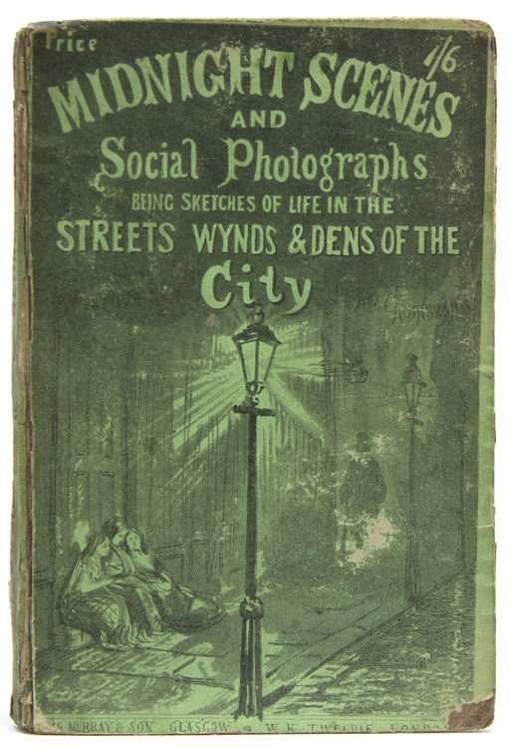

Slide 29
in life the seer should watch that pattern among general things … and describe that alone. This is, quite accurately, a going to Nature; yet the result is no mere photograph, but purely the product of the writer's own mind.
Florence Emily Hardy, The Life of Thomas Hardy (London: Macmillan, 1970), 153.
Art is a disproportioning -- (i.e. distorting, a throwing out of proportion) - of realities, to show more clearly the features that matter in those realities, which, if merely copied or reported inventorily, might be possibly observed, but more probably would be overlooked. Hence 'realism' is not art.
Florence Emily Hardy, The Life of Thomas Hardy (London: Macmillan, 1970), 229.

Slide 30
‘fashionable cooking and stippling of sitters’ faces until the texture of the skin is nothing but that of white kid gloves.’
George Bernard Shaw, ‘Photographic Impostures, What the Worlds Says,’ 1887, The World, 12 October, 1887.

Slide 32
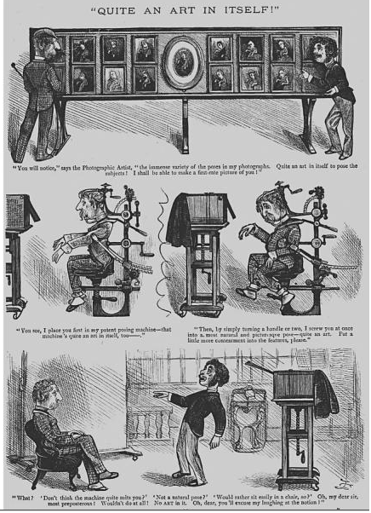

Slide 33
‘She had never been satisfied with the portraits which professional photographers made for her. She felt sure that her sweetest expression had not been caught by the camera, as she often saw it in her mirror. Having a camera with the usual attachment for taking instantaneous views, she has spent her leisure hours for a week or two in making negatives of her own visage. A string hitched to the trigger of the instrument enables her to be both operator and subject; and thus, in the privacy of her chamber . . . she transfers her smiles or frowns to the plates to be subsequently developed into photographs, in case she deems them worth it. She has thus far made one hundred and sixty-seven different pictures of herself.’ The Amateur Photographer, July 24 1885, 242.

Slide 34
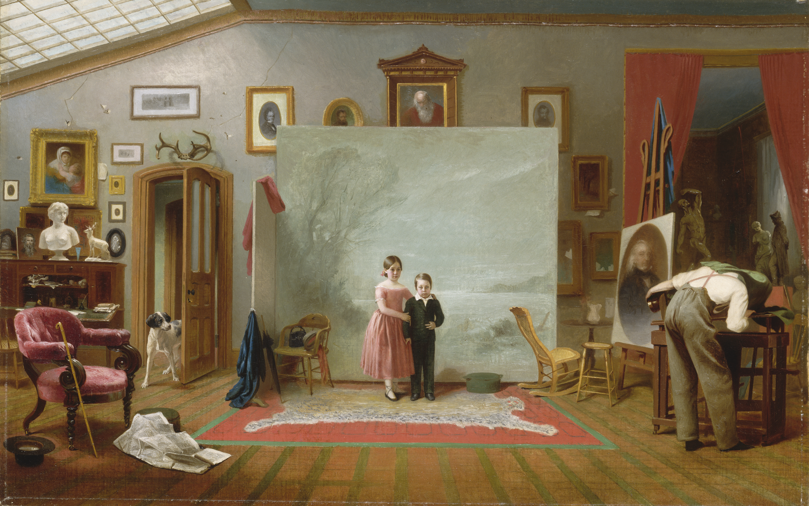

Slide 35
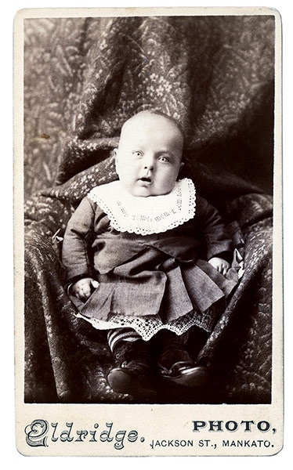

Slide 36
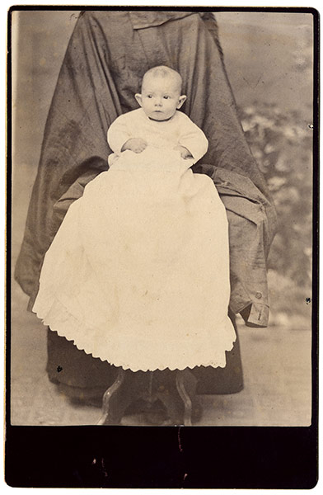

Slide 37
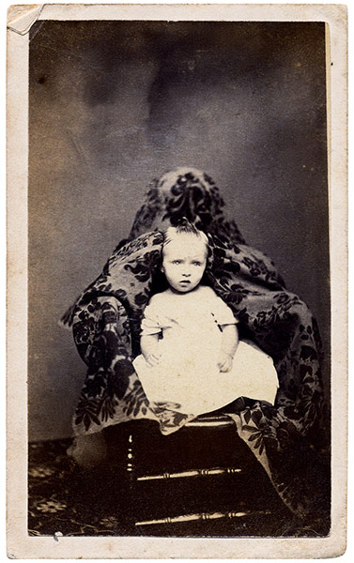

Slide 38
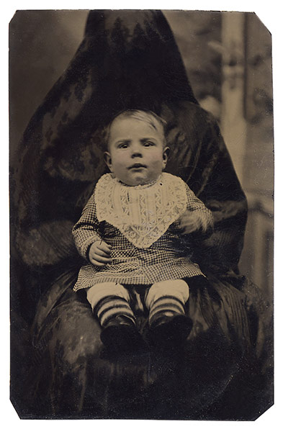

Slide 39
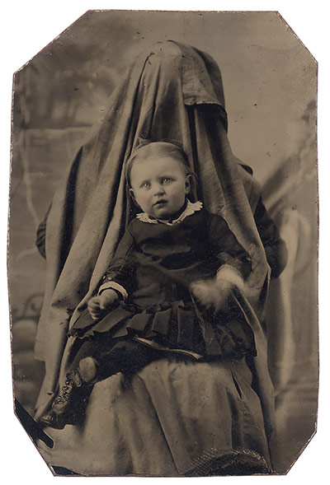

Slide 40
‘She had never been satisfied with the portraits which professional photographers made for her. She felt sure that her sweetest expression had not been caught by the camera, as she often saw it in her mirror. Having a camera with the usual attachment for taking instantaneous views, she has spent her leisure hours for a week or two in making negatives of her own visage. A string hitched to the trigger of the instrument enables her to be both operator and subject; and thus, in the privacy of her chamber . . . she transfers her smiles or frowns to the plates to be subsequently developed into photographs, in case she deems them worth it. She has thus far made one hundred and sixty-seven different pictures of herself.’ The Amateur Photographer, July 24 1885, 242.

Slide 41
I WANT to explain how a family, a small group of human beings, comports itself in a society…Taking into account the two-fold question of temperaments and environments, I shall try to find and trace out the thread which … leads mathematically from one man to another. And … when I hold a whole social group in my hands, I shall show this group in action … I shall analyze at the same time both the total will of its individual members and the general drive of the whole body…Physiologically the members of this family are the slow working-out of accidents to the blood and nervous system which occur in a race after a first organic lesion, according to the environment determining in each of the individuals of this race... Historically they originate in the lower classes, spread out through all of contemporary society, climb to every eminence under that essentially modern impulsion which the lower classes receive on their way through the whole social body. - ZOLA 1871

Slide 42
18. An oblong box painted reddish brown lay on the seat beside her. A woman of seven or eight and thirty, stout and strongly built, short arms and hard-worked hands, dressed in dingy black skirt and a threadbare jacket too thin for the dampness of a November day. Her face was a blunt outline, and the grey eyes reflected all the natural prose of the Saxon.
George Moore, Esther Waters (1894)

Slide 43
But our social novels profess to represent the people as they are, and the unreality of their representations is a grave evil. The greatest benefit we owe to the artist, whether painter, poet, or novelist, is the extension of our sympathies. Appeals founded on generalizations and statistics require a sympathy ready-made, a moral sentiment already in activity; but a picture of human life such as a great artist can give, surprises even the trivial and the selfish into that attention to what is a part from themselves, which may be called the raw material of moral sentiment. When Scott takes us into Luckie Mucklebackit's cottage, or tells the story of "The Two Drovers;" when Wordsworth sings to us the reverie of “Poor Susan” – George Eliot, ‘The Natural History of German Life’

Slide 44
18. An oblong box painted reddish brown lay on the seat beside her. A woman of seven or eight and thirty, stout and strongly built, short arms and hard-worked hands, dressed in dingy black skirt and a threadbare jacket too thin for the dampness of a November day. Her face was a blunt outline, and the grey eyes reflected all the natural prose of the Saxon. George Moore, Esther Waters (1894)

Slide 46
19. Cabs whisked about, with the 'fare' as carefully boxed up behind two glazed calico curtains as any mysterious picture in any one of Mrs. Radcliffe's castles; omnibus horses smoked like steam-engines; nobody thought of 'standing up' under doorways or arches; they were painfully convinced it was a hopeless case; and so everybody went hastily along, jumbling and jostling, and swearing and perspiring, and slipping about, like amateur skaters behind wooden chairs on the Serpentine on a frosty Sunday.

Slide 47
20. 'Did you ever!'--said a little coquette with a large bustle, who looked like a French lithograph, appealing to a gentleman in three waistcoats--'Did you ever!'’ Charles Dickens, ‘The Bloomsbury Christening’, in The Monthly Magazine, April 1834.

Slide 48
23. ‘He looked like a faded giant, with the head and face partially restored; and he had a cast in his eye which rendered it quite impossible for any one with whom he conversed to know where he was looking. His eyes appeared fixed on the wall, and he was staring you out of countenance; in short, there was no catching his eye, and perhaps it is a merciful dispensation of Providence that such eyes are not catching’
Charles Dickens, ‘The Bloomsbury Christening’.

Slide 49
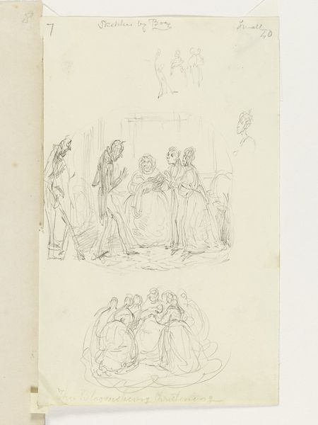

Slide 51
The Gothic is an apt form in which to express the feelings of the powerless. It is apt where the workings of cause and effect are veiled, as they are from the slaves; it is no use for them to reason about their situation, because they are the victims of caprice, and rationality cannot save them. Gothic convention can survive, and diversify, because of its emotional and situational truth. It is always vastly exaggerated, and at the same time, there is always some culture, some spot on the map, where it is all literally true
Hilary Mantel, ‘The Shape of Absence’, a review of The Bondswoman’s Narrative in London Review of Books, 8 August 2002 http://www.lrb.co.uk/v24/n15/mant01_.html

